Slide 2
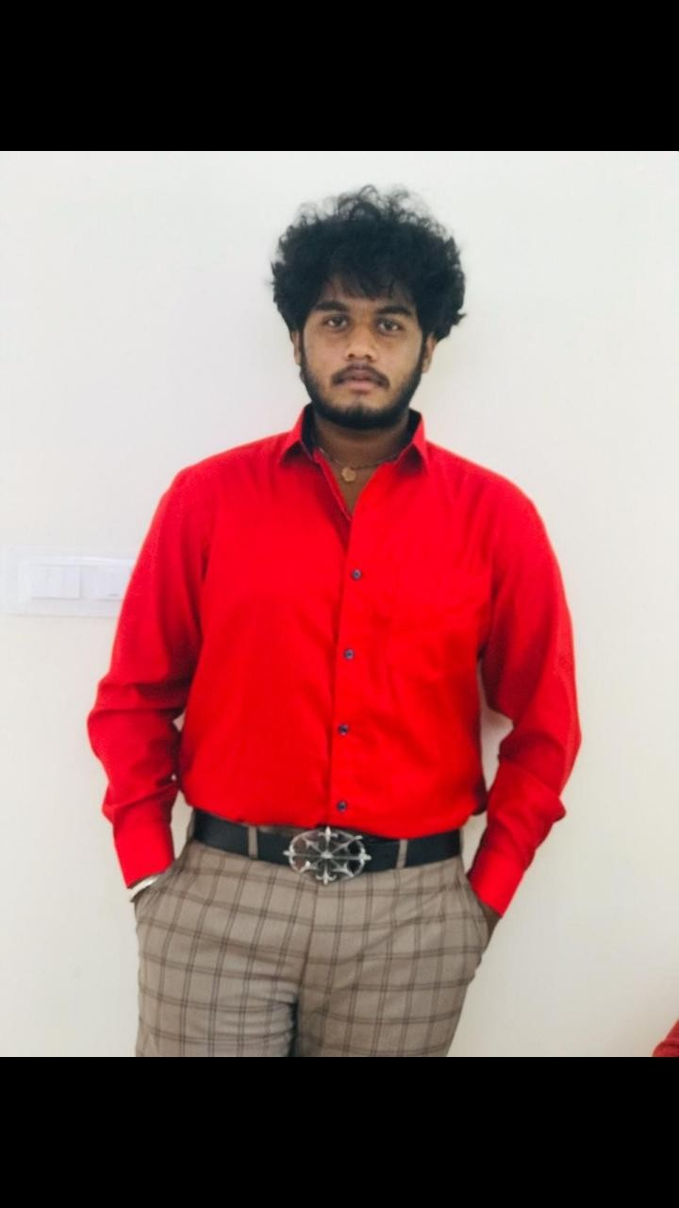
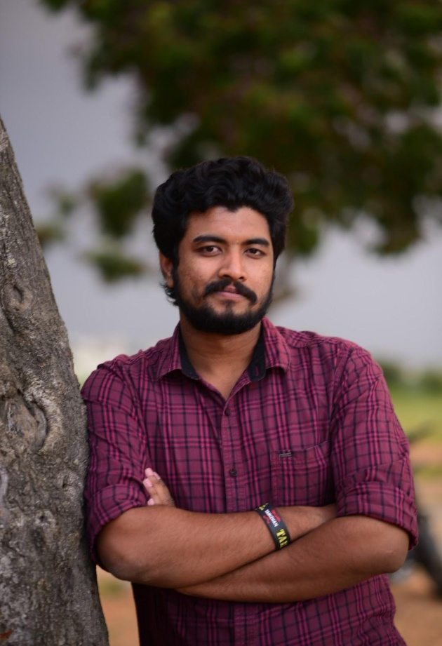
SHREYAS PRABHU
DIRECTOR
ANKIT CHOUDHARY
DOP AND EDITING
PRINCE JOSEPH
MUSIC

Slide 3
CAST
Manju
Amulya
Sinchana
Kishan
Lakshan
Anish

